Slide 1


Creating an Activity Planning and Publishing dApp on Solana
Create a user-friendly dApp for activity planning and sharing that enables participation, hosting, and social interaction, all based on the fast and secure Solana blockchain.
By Xing

Slide 2

What is Solana?
Solana is a high-performance blockchain that uses proof-of-stake consensus to achieve lightning-fast transaction speeds and low fees. With features like its own programming language and easy access to smart contracts, Solana is quickly becoming a leading platform for dApp development.

Slide 3
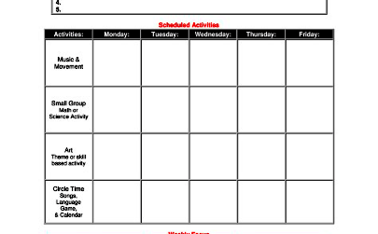
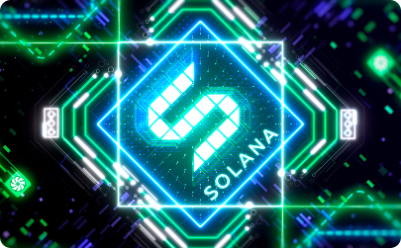
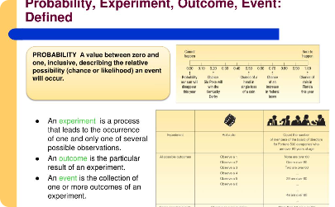
Creating a dApp on Solana
Activity Planning and Publishing
Implementation Plan
Anticipated Outcomes
Develop a detailed implementation plan using Solana's programming language or smart contract platforms.
Create an intuitive, streamlined dApp that connects activity organizers with participants and hosts, leading to a higher number of events and increased social interaction.
Enable activity organizers to easily publish and share events, while providing a seamless sign-up process for participants and hosts.

Slide 4

User Requirements
1
User Friendship
2
Fast Transactions
3
Distributed Network
The dApp interface should be user-friendly for both activity organizers and participants/hosts.
Transactions on the dApp should be fast and cheap. It should support a large number of transactions at low latency.
The dApp should be open-collaboration for developers across the network.

Slide 5
Competitive Analysis
Eventbrite
Meetup
High fees and slow transaction times, leading to poor user experiences.
User-generated event creation and promotion, but limited features for hosting events.
Facebook Events
Solana's dApp
Established network, but limited control over event planning and sharing.
Fast transactions, low fees, and open-collaboration with developers, leading to a better user experience.

Slide 6
Features of the dApp
1
Activity Sharing
Publicize and share activities with users with similar interests.
2
Participation and Hosting
Enable organizing, viewing, and attending various activities, with real-time status updates.
3
Social Interaction
Allow users to connect, share, and interact socially on activities. Users can also rate and review others' events.

Slide 7




Contact Our Team
Developer
Business Development
Designer
Our developers are expertise in building dApps on Solana.
Our business development team will help you create and launch your event.
We can assist in designing the optimal user interface for easy use and excellent UX.

Slide 8
Conclusion
Future of event planning on blockchain
Increased social interaction
With a user-friendly interface and unique social features, our dApp will enable users to connect and share their interests and experiences.
Solana's dApp offers fast and reliable event planning and hosting, supercharged by blockchain technology.

